Slide 1
7.1 - Introduction to Project #1
Project Week

Slide 2
User story
Audience
General Population; especially parents, travelers, health care workers, and caregivers who work with the elderly
Problem
Need to have quick access to latest outbreak information
Solution
Create app that used CDC & MAP API to quickly gather Corona Virus information

Slide 3
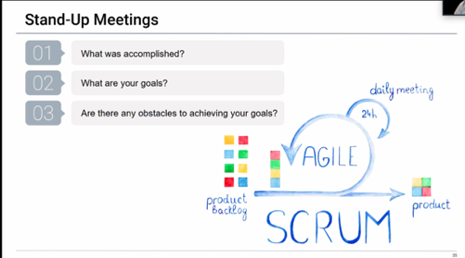
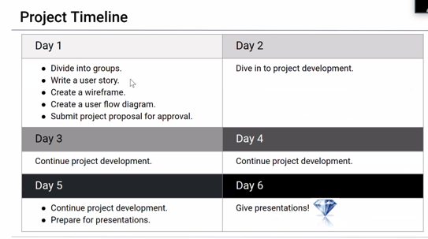
Daily scrum
Goal: To create a series of web pages containing information on the COVID-19
virus, including symptoms of the disease, a statistics page for cases by country, and a choropleth map for showing what states had the most cases.
Accomplishments: We achieved our goal of making a tracker for the United States as a starting point. The choropleth map was also working, but had color distribution issues.
Obstacles: The data being accessed originally listed statistics by state. Two days before the project was due, the creator made the statistics show by city.

Slide 4
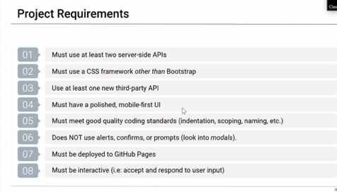
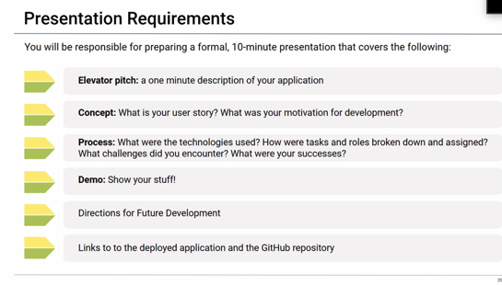
Process

Slide 5
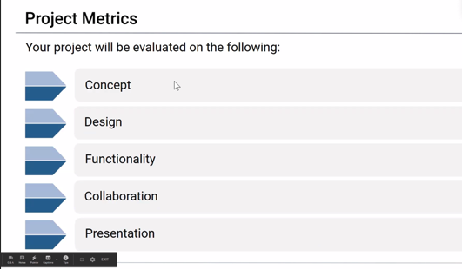
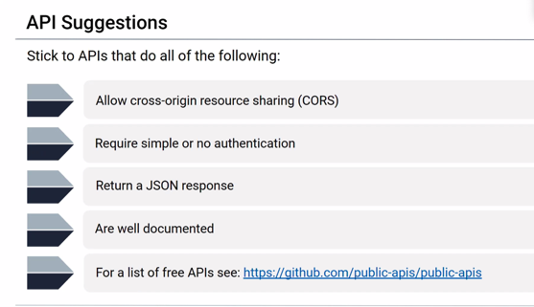
Demo

